Slide 1
Making the Connection: High-Impact Organizational Communication
December 7, 2022

Slide 2
Webinar Housekeeping
Today’s presentation is being recorded – The links to the view the recording and download the presentation on-demand will be shared with all participants. Webinar links will also be posted on AMGA’s website within the next few days.
All lines have been placed on mute to prevent any background noise.
Please use the Q&A section of the system to submit your questions anytime during the presentation, and our speakers will address them at the end. Please submit comments in the Chat section only.
AMGA will not provide your email address to TPG unless we have your permission. If you would like a representative from TPG to contact you after the webinar, please let us know in the chat box and we will share your information.

Slide 3





Rise to the Challenge.
Rise to Immunize™ (RIZE)
AMGA Foundation’s third national health campaign
Enroll at
RiseToImmunize.org
Questions?
RiseToImmunize@amga.org
Four-year campaign focused on improving rates of four types of adult immunizations
Together we can administer
25 million vaccines by 2025
Notes:
Rise to Immunize (RIZE) is AMGA’s third national campaign – focused on improving adult immunization rates for influenza, pneumococcal, Td/Tdap, and zoster.
More than 60 AMGA members have joined RIZE and are working with their peers to collectively administer 25 million vaccines by 2025.
Campaign participants are able to benchmark progress against peers nationwide and leverage best practices and tools from the highest performers to drive improvement within their own organizations.
The 2023 vaccination season is around the corner, so it’s a great time to join us.
Learn more at RiseToImmunize.org or email RiseToImmunize@amga.org.

Slide 4


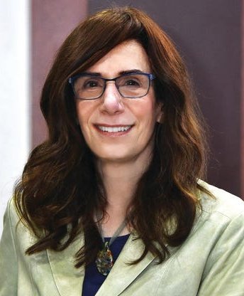
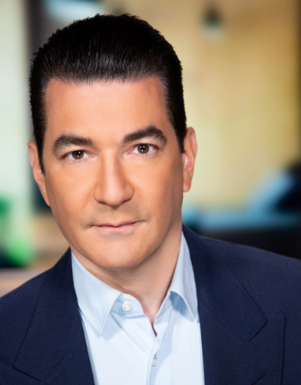

Chef José Andrés
Chef, Restauranteur, Humanitarian
Judy Faulkner
Founder & CEO, Epic
Scott Gottlieb, M.D.
23rd Commissioner of U.S. FDA
Joan Higginbotham
Retired NASA Astronaut
March 28-31, 2023
|
|
|
amga.org/AC23
Hyatt Regency Chicago
Chicago, Illinois

Slide 5
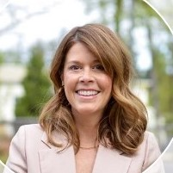
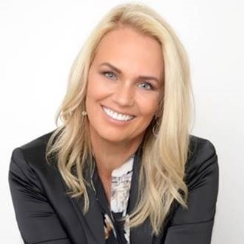
Speakers
Holly Witt
Group Physician Advisory Services Practice Leader
The Partners Group
Wendy Korthuis-Smith, Ed.D., M.S.
Executive Director
Virginia Mason Institute

Slide 6
MAKING THE CONNECTION
High Impact Organizational Communication
Holly Witt & Wendy Korthuis-Smith
December 7, 2022

Slide 7
AGENDA
The Why
Elements of a Good Communication Philosophy
Bridging Philosophy and Execution
Effective Communication Tactics
Tools and Mediums
Case Studies

Slide 8
The Why

Slide 9



THE WHY
Attracting and retaining Clinician talent
COMPETITION FOR CLINICIAN TALENT IS AT AN ALL-TIME HIGH
534,00 healthcare and social assistance workers who quit their jobs in August 2021.¹
PREDICTED PHYSICIAN SHORTAGES
37,000– 124,000
Range of the projected shortage of physicians by 2034.¹
ENGAGED
EMPLOYEES STAY
Employees with the highest levels of engagement are 87% less likely to voluntarily leave their employer.²
¹https://www.hfma.org/topics/hfm/2021/december/soaring-labor-costs-stemming-from-covid-19-test-hospitals-and-he.html
²https://www.zippia.com/advice/employee-engagement-statistics/

Slide 10



THE WHY
Attracting and retaining Clinician talent
REPLACEMENT COSTS ARE ASTRONOMIC
$500,000 - $1,000,000 Estimated cost of
replacing a
single physician.³
ENGAGED EMPLOYEES CREATE COMPETITIVE ADVANTAGE
Engaged employees provide a competitive advantage, such as higher productivity and lower employee turnover.⁴
DISENGAGEMENT IMPACTS THE
BOTTOM LINE
Costs companies $3,400
for every $10,000 an average disengaged employee earns per year.⁵
³https://www.ama-assn.org/practice-management/physician-health/how-much-physician-burnout-costing-your-organization
⁴https://pumble.com/learn/communication/communication-statistics/#Effective_communication_increases_productivity
⁵https://www.zippia.com/advice/employee-engagement-statistics/

Slide 11
THE WHY
The Quadruple Aim and clinician engagement
Productivity
Improved Clinician Experience
Cultural
Alignment
Trust
Better Outcomes
Clinician Engagement
Well-being
Retention
Lower Costs
Improved Patient Experience

Slide 12





The why
The Quadruple Aim and the clinician experience
Effective communication with your population can evoke greater levels of engagement.
Engaged employees are more 22% productive at work than employees who are not engaged.²
Engaged employees are 21% more profitable than disengaged employees.²
The top 20% of engaged employees have a 41% reduction in absenteeism and a 59% reduction in employee turnover.²
Improved Physician engagement translates to better outcomes, lower costs and an
improved patient experience.
²https://www.zippia.com/advice/employee-engagement-statistics/

Slide 13
Elements of a Good Communication Philosophy

Slide 14

No company, large or small, can succeed over the long run without energized employees who believe in the mission and understand how to achieve it."
Jack Welch

Slide 15


Communication Philosophy

Slide 16
Get Clear on
Your Objective
Desired Outcome
Start with the end in mind...
What is your desired outcome?
Notes:
.

Slide 17
Get Clear on
Your Objective
Who are you trying to reach?
What are you trying to say?
Desired Outcome
To…? So that…?
How can you
best reach your target audience?
Why are you trying to say it?

Slide 18
Get Clear on
Your Objective
Core-Values Based
Clarity
Who are you trying to reach?
What are you trying to say?
Desired Outcome
Precision
Concision
Apply the elements of your philosophy to achieve your desired outcome.
How can you
best reach your target audience?
Why are you trying to say it?
Resonance
Unity

Slide 19
“When people are financially invested, they want a return.
When people are emotionally invested, they want to contribute.”
Simon Sinek

Slide 20
STRUCTURAL ASSURANCES FOR COMMUNICATION & LINKAGES
Bridging Philosophy & Execution

Slide 21
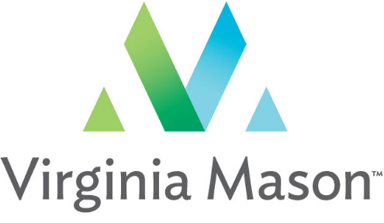
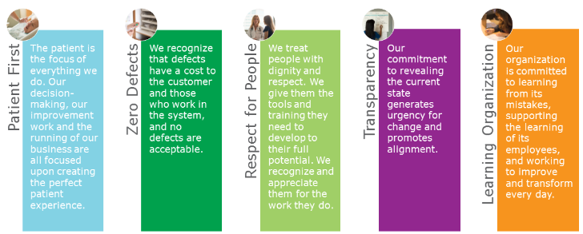
Our Beliefs
Notes:
Examples-
High level touch/why do we have how to use.
Recruit-retention-day to day work

Slide 22
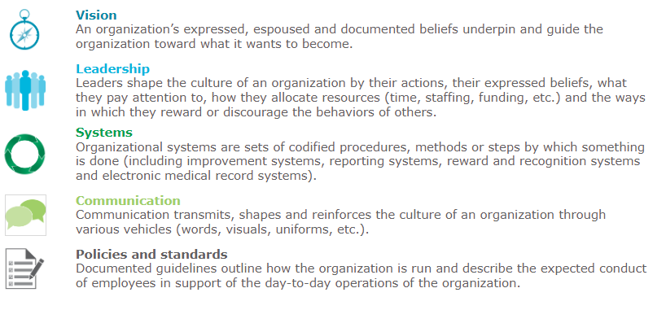
Domains of Organizational Culture
Notes:
What is critical - permeate through all communications.

Slide 23
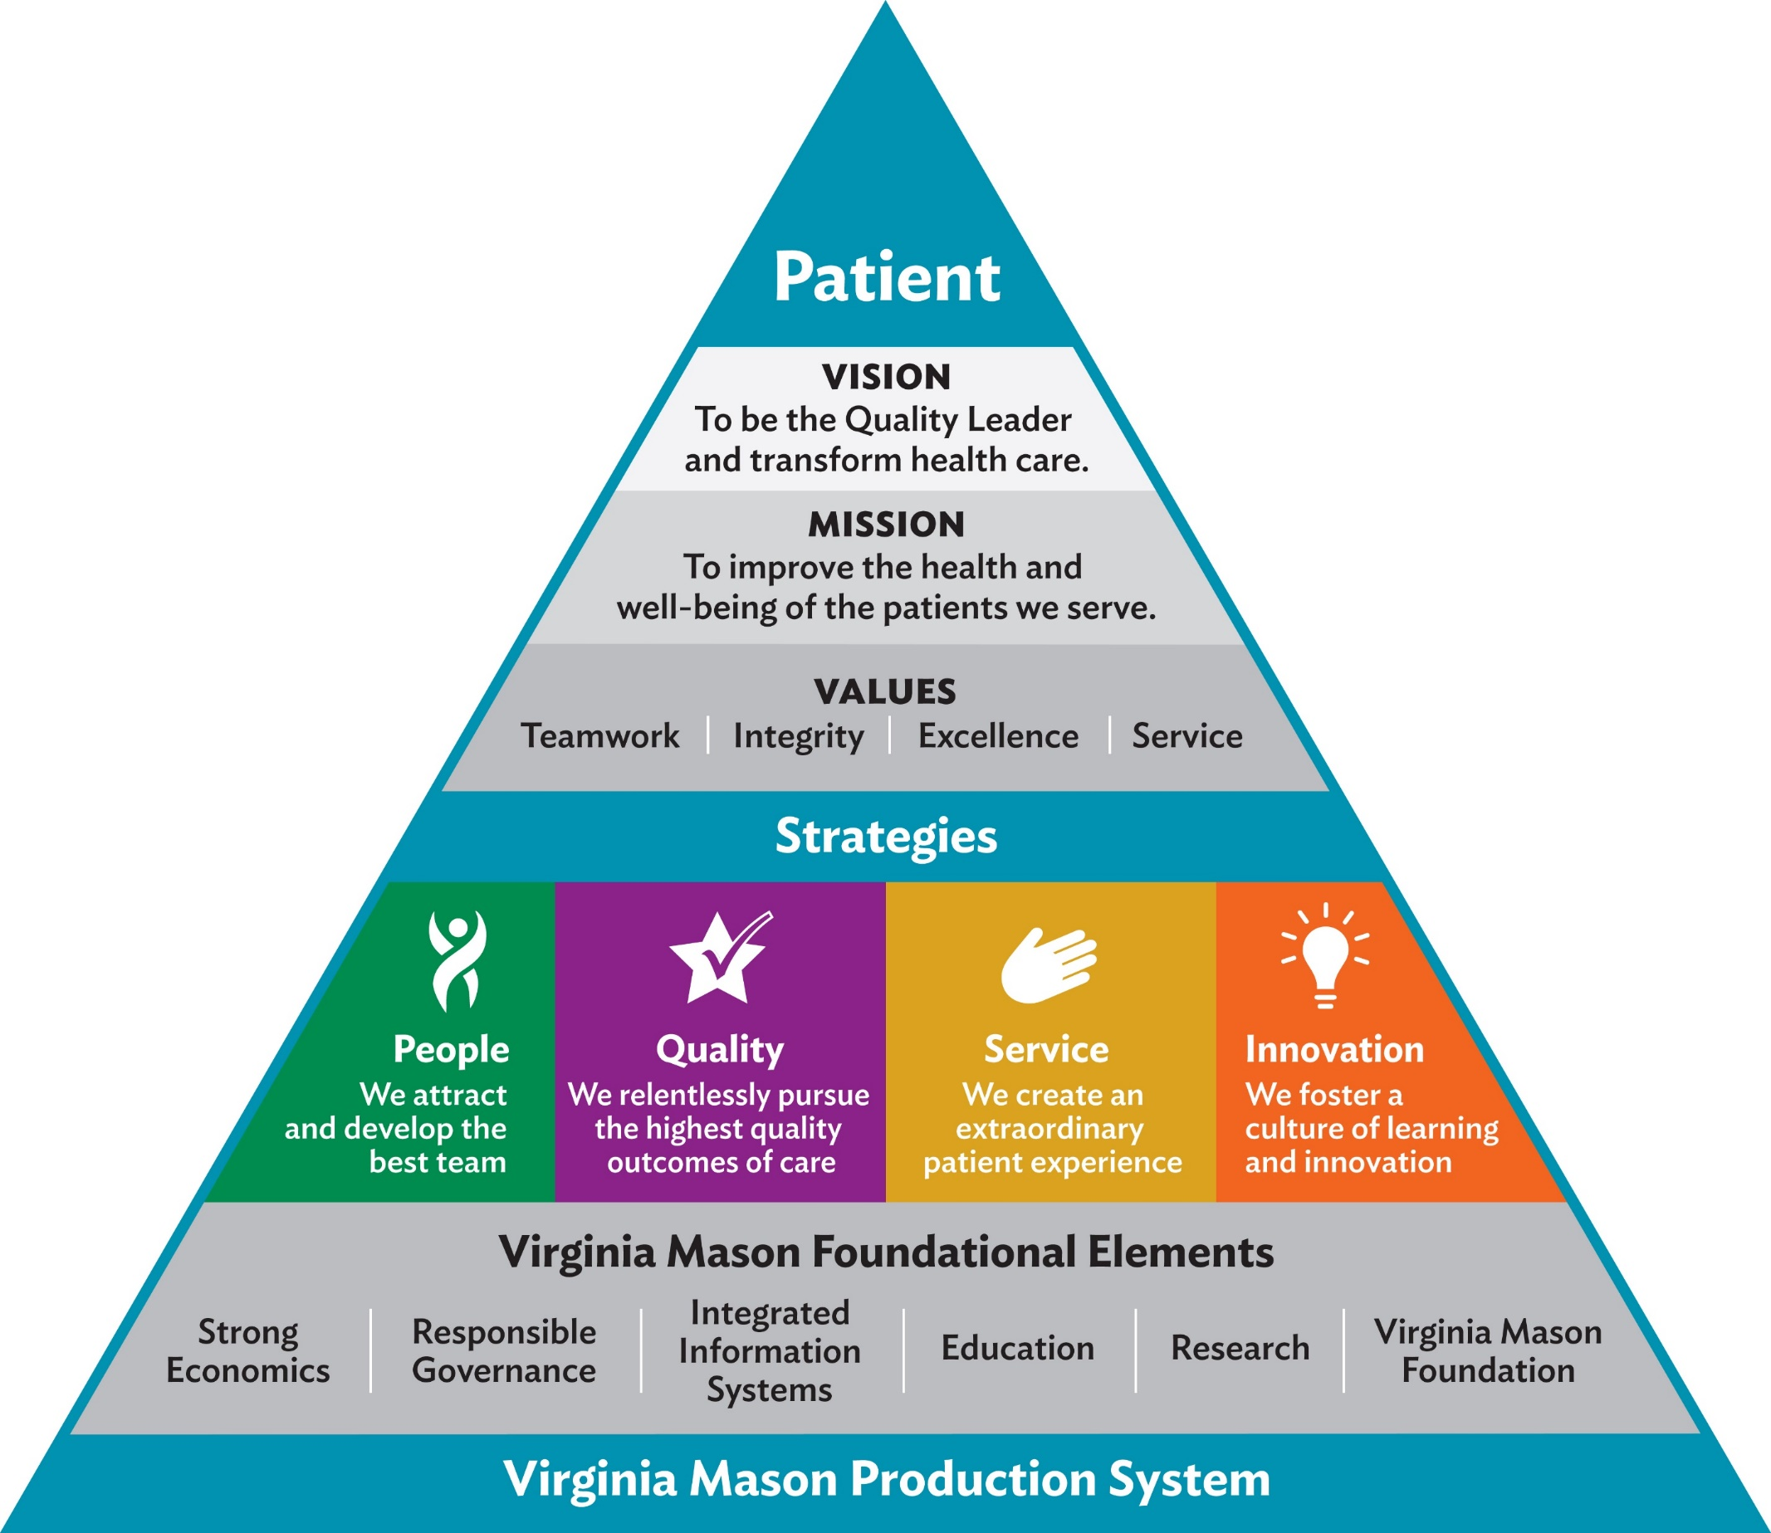
Virginia mason: our strategic plan
Notes:
From bottom to top, all the ways they need to connect their people

Slide 24
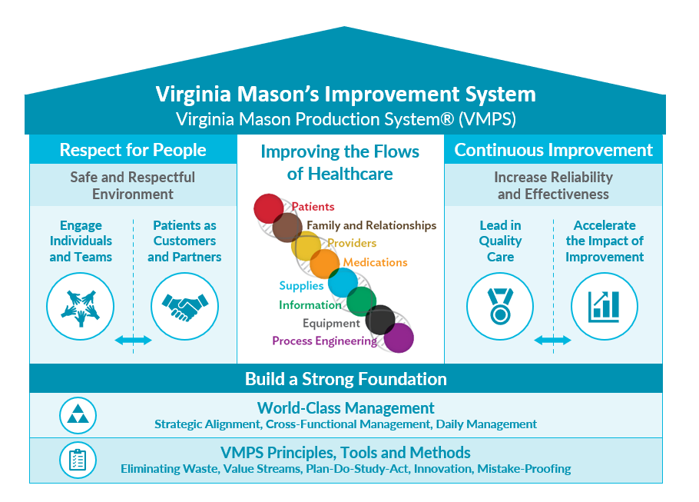
VMPS: Principles, Tools, Methods
Notes:
Slightly different look, foundation, house/pillars

Slide 25
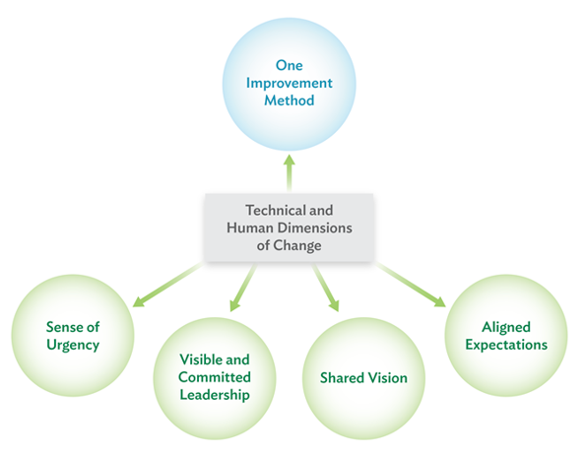
Philosophy/Requirements for Transformation
Communicate urgency
Lead from the genba
Establish a shared vision
Make expectations transparent
Engage team in change
“Go see, ask why, show respect”
Celebrate, recognize, sustain
Notes:
While applying UHCWi (improvement method), it is necessary for leaders to demonstrate these behaviors to transform the org.’s process improvement culture:
Create a sense of urgency (e.g., zero defects) (Kotter’s model)
Be visible and responsive as you lead from the genba, sharing updates regularly, listening to feedback, and building relationships (e.g., executive rounding, visual management boards)
Commit to a shared vision as you engage the team in change
Use humble inquiry to build relationships with frontline staff and learn from their experiences – ‘go see, ask why, show respect’
Align behavior and performance with the vision by making expectations transparent
Celebrate and recognize the team’s work and acknowledge their effort
These are aspects of dealing with with not only the technical changes, but the human dimensions of change we call the adaptive changes needed for transforming the culture (e.g., such that UHCWi is used day in, day out, by frontline staff and all leaders)

Slide 26

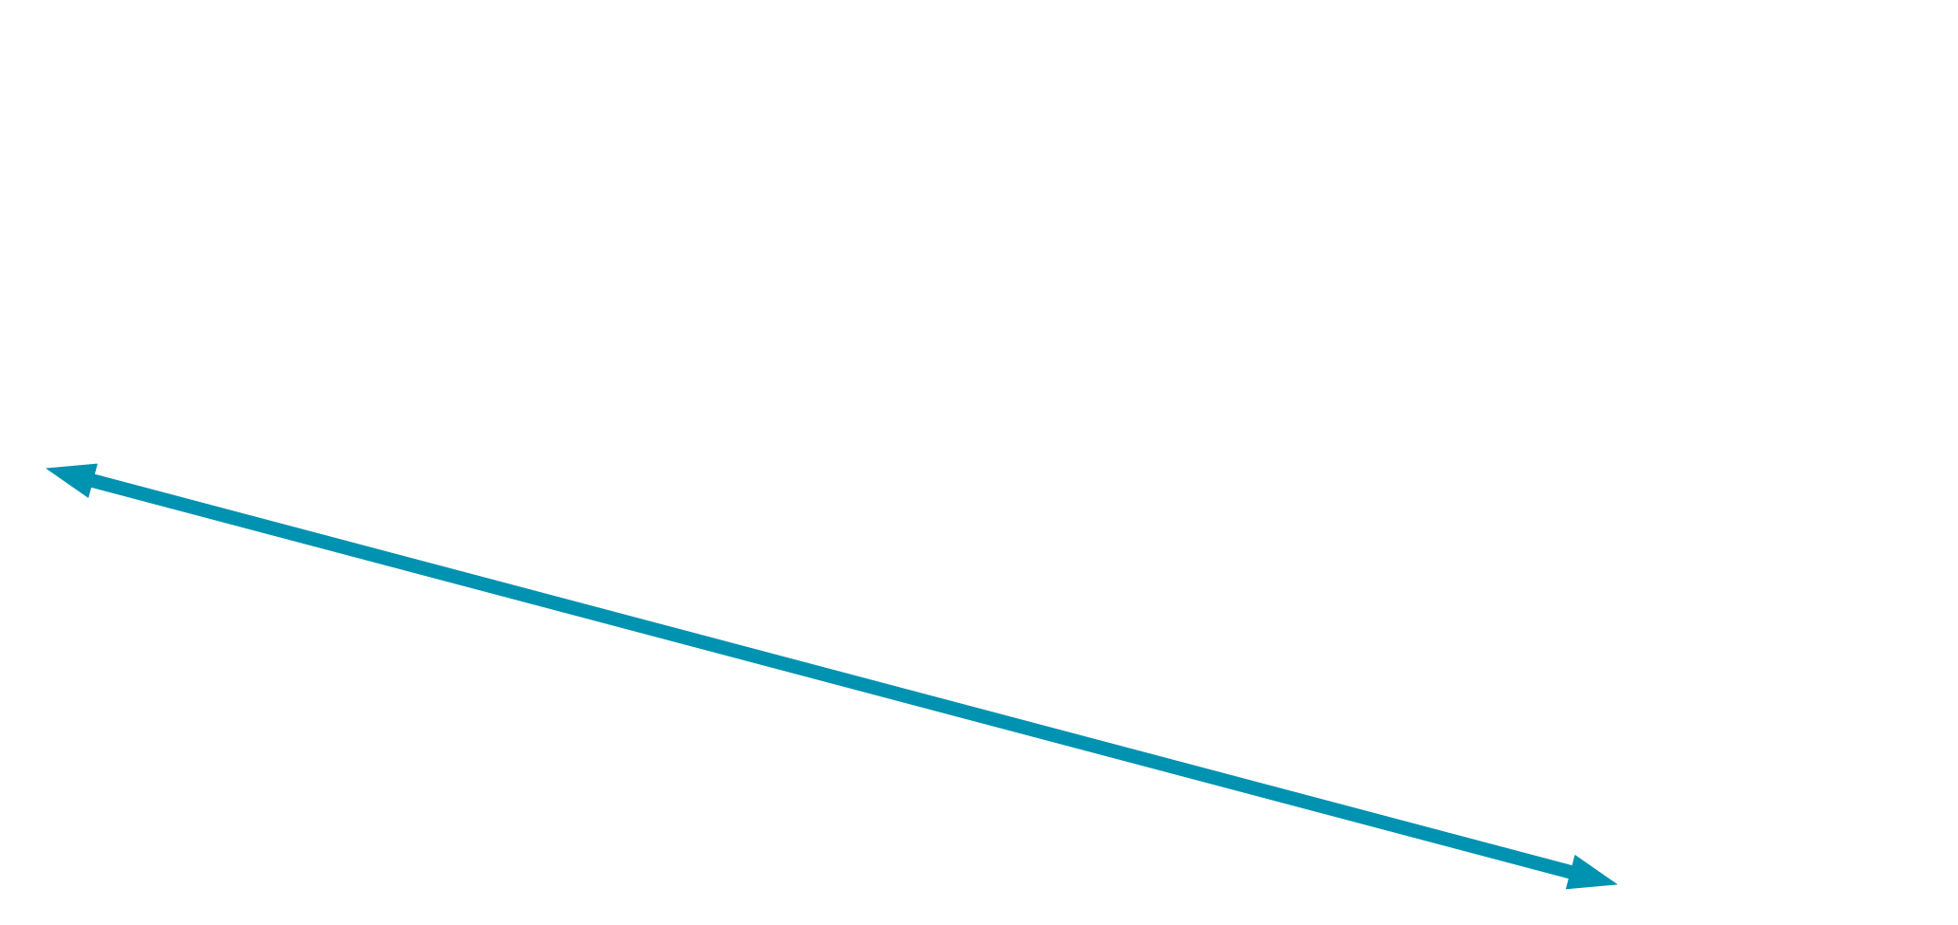
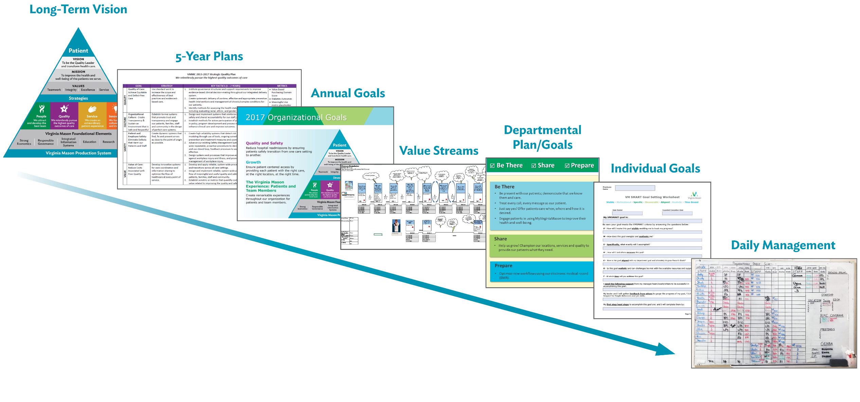
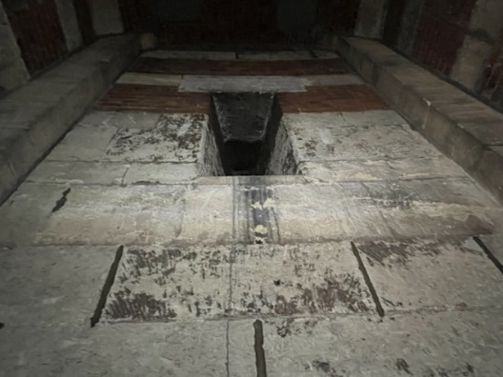
Strategic Alignment: Aligning Vision and Strategy
Notes:
Golden thread – linking comms well to reach desired outcome.

Slide 27
Tools & Mediums
Notes:
Transition back to Holly

Slide 28








Finding the proper medium
How to send the message to ensure the call gets completed
Email
Intranet
Internal publication
Meetings
Interactive tools/video
Portals
Smart apps
US Mail

Slide 29



Improving resonance
Additional considerations for making the connection with your target audience
AESTHETIC
Brand assets,
colors, common
graphics, themes
LANGUAGE
A special tone of voice,
a form of expression that distinguishes the company externally and internally.
CADENCE
Align on frequency and then plot on calendar.

Slide 30
MAKING THE IMPLICIT EXPLICIT
Effective Communication Tactics
Notes:
Wendy, can you share what your team at VM employs in making the implicit explicit?

Slide 31
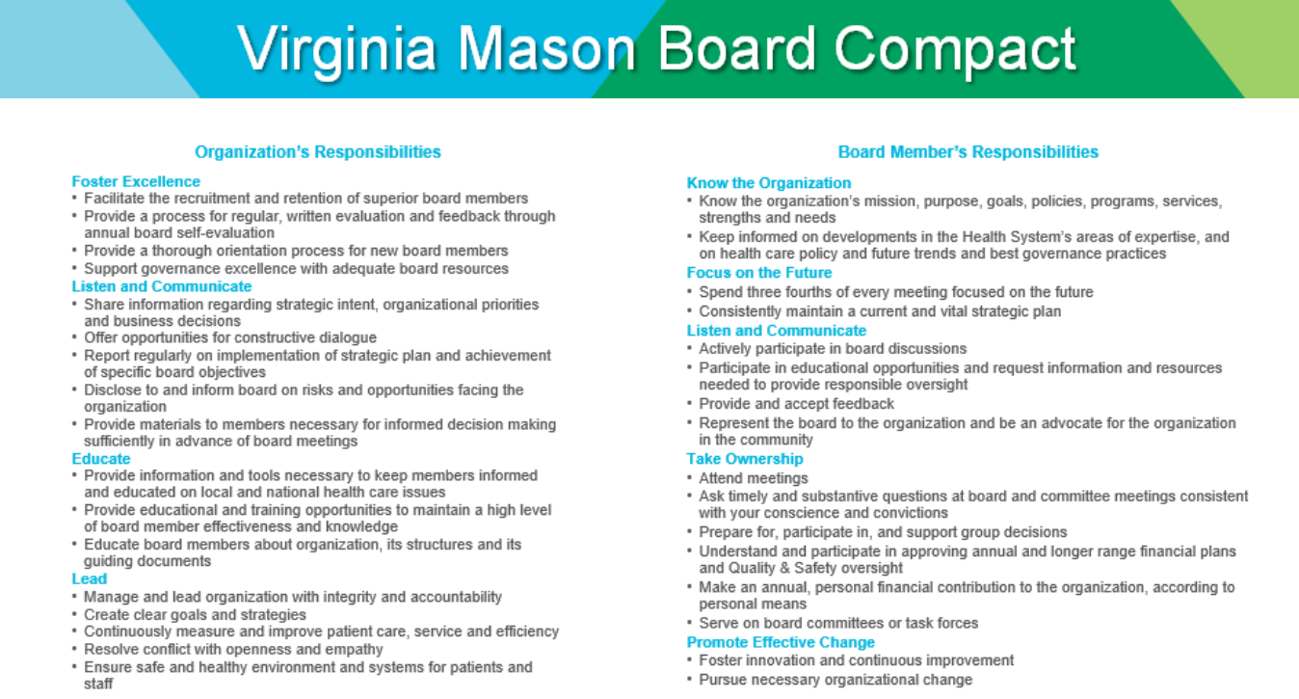
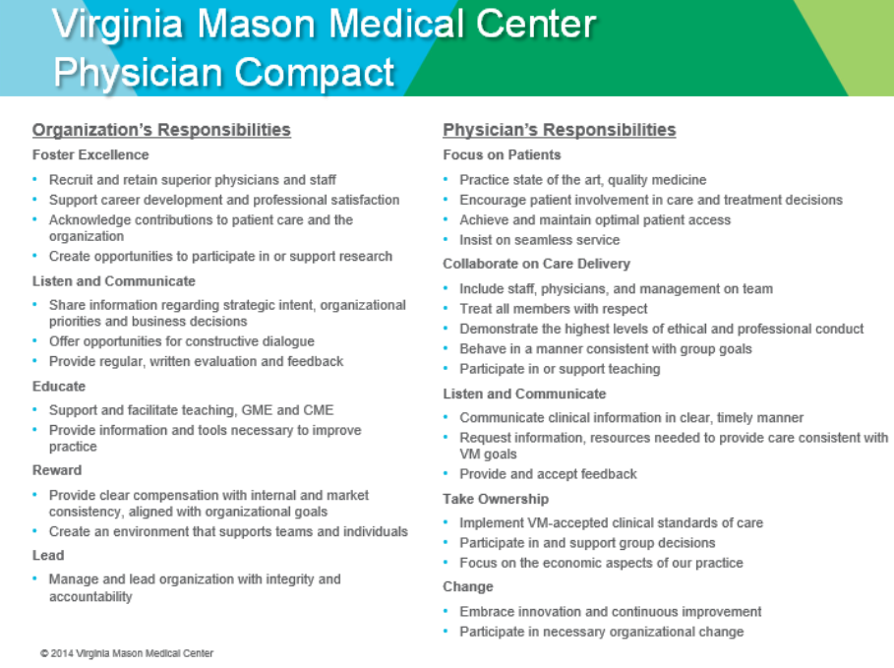
Aligned Expectations with Compacts
Notes:
Holly-Question-example of a compact
VM has three different compacts, for 1) the Board; 2) leadership and 3) physicians.
Why are these important to us?
Because they establish behavioral expectations, which are the heart of culture.
Dialogue using these Compacts leads to specific behaviors needed to support our organizational vision, mission and values.
And consistent management and reshaping of these compacts helps the culture evolve to support the organization’s success over time.

Slide 32
Being Explicit: Quality Definition
Q = A × (O + S)
W
Q: Quality | A: Appropriateness | O: Outcomes | S: Service | W: Waste
Notes:
Old way =- restore order, status quo
New way – expose conflict, or let it emerge
Don’t silence whistle blowers, ‘creative deviants’, others exposing contradictions
Their perspectives can provoke fresh thinking- and they may be a future leader in your organization
Expose conflict

Slide 33

Incorporating Catchball
Process for obtaining and integrating feedback on organizational priorities
Sharing the “Why”
Provides direction and alignment across the organization
Seeks to engages everyone in the process
Helps all team members understand the organizational strategies and their individual role in the work
Senior Leadership
All Leadership
All Team Members
Notes:
The Catchball phase is where we put together the environmental scan results and our initial draft of our next years goals and go out into the organization to create a dialogue. The term Catchball is used to reflect that the leaders “throw” or “pitch” the goals out into the organization for input and then they are thrown back to us for revisions.

Slide 34
Example Strategies

Slide 35
A Journey Toward Communicating Respect
and Inclusion
2018
Refreshing Respect 2.0
Leadership and physician compacts
Town halls
Peoplelink
Patient Safety Alert and Response/ Workplace Safety
Schwartz Rounds/Belonging Groups
2012
Respect for People
Team discussion guides
Vignettes recorded
2018 (cont)
Health Equity/Inclusion
Talent and Leadership Development Programs
Respect for People behaviors updated to reflect importance of DEI
Respect for People Summit with over 5400 participants trained
Going deeper….
Providing toolkits to speaking up to disrespect, know and go, and other tools
2020
Promoting all voices
Common language
Pilot equity learning toolkit
Equity pauses
Notes:
2012
Respect for People Behaviors Defined, Launched and All Staff Trained – In our team members’ words
Team discussion guides implemented
Vignettes recorded
2018
Refreshing Respect 2.0 and weaving into the organization
Leadership and physician compacts
Town halls and listening sessions
Peoplelink
Patient Safety Alert and Response/ Workplace Safety
Schwartz Rounds/Belonging Groups
Safety rounds/Patient Co-design
Health Equity/Inclusion
Talent and Leadership Development Programs
Respect for People behaviors updated to reflect importance of DEI
Respect for People Summit with over 5400 participants trained
Going deeper….
Providing toolkits to speaking up to disrespect, know and go, and other tools
2020
Promoting all voices
Common language
Pilot equity learning toolkit
Equity pauses

Slide 36

TPG Case studies: THE WORK IN ACTION
Case Study One: wellbeing guide
“Why”
Elements
Bridging
Tools / mediums

Slide 37

TPG Case studies: THE WORK IN ACTION
Case Study Two: effective EAP deployment
“Why”
Elements
Bridging
Tools / mediums

Slide 38
THANK YOU
HOLLY WITT
hwitt@tpgrp.com
(503) 597-6326
WENDY KORTHUIS-SMITH
Wendy.Korthuis-Smith@virginiamason.org
(360) 790-1777

