Slide 1
Preparing for an Evolving Alzheimer’s Treatment Landscape:
Patient and Thought Leader Insights
May 17, 2023

Slide 2
Webinar Housekeeping
Today’s presentation is being recorded – The links to the view the recording and download the presentation on-demand will be shared with all participants. Webinar links will also be posted on AMGA’s website within the next few days.
All lines have been placed on mute to prevent any background noise.
Please use the Q&A section of the system to submit your questions anytime during the presentation, and our speakers will address them at the end. Please submit comments in the Chat section only.

Slide 3





Rise to the Challenge.
Rise to Immunize™ (RIZE)
AMGA Foundation’s third national health campaign
Enroll at
RiseToImmunize.org
Questions?
RiseToImmunize@amga.org
Four-year campaign focused on improving rates of four types of adult immunizations
Together we can administer
25 million vaccines by 2025
Notes:
Rise to Immunize (RIZE) is AMGA’s third national campaign – focused on improving adult immunization rates for influenza, pneumococcal, Td/Tdap, and zoster.
More than 60 AMGA members have joined RIZE and are working with their peers to collectively administer 25 million vaccines by 2025.
Campaign participants are able to benchmark progress against peers nationwide and leverage best practices and tools from the highest performers to drive improvement within their own organizations.
The 2023 vaccination season is around the corner, so it’s a great time to join us.
Learn more at RiseToImmunize.org or email RiseToImmunize@amga.org.

Slide 4


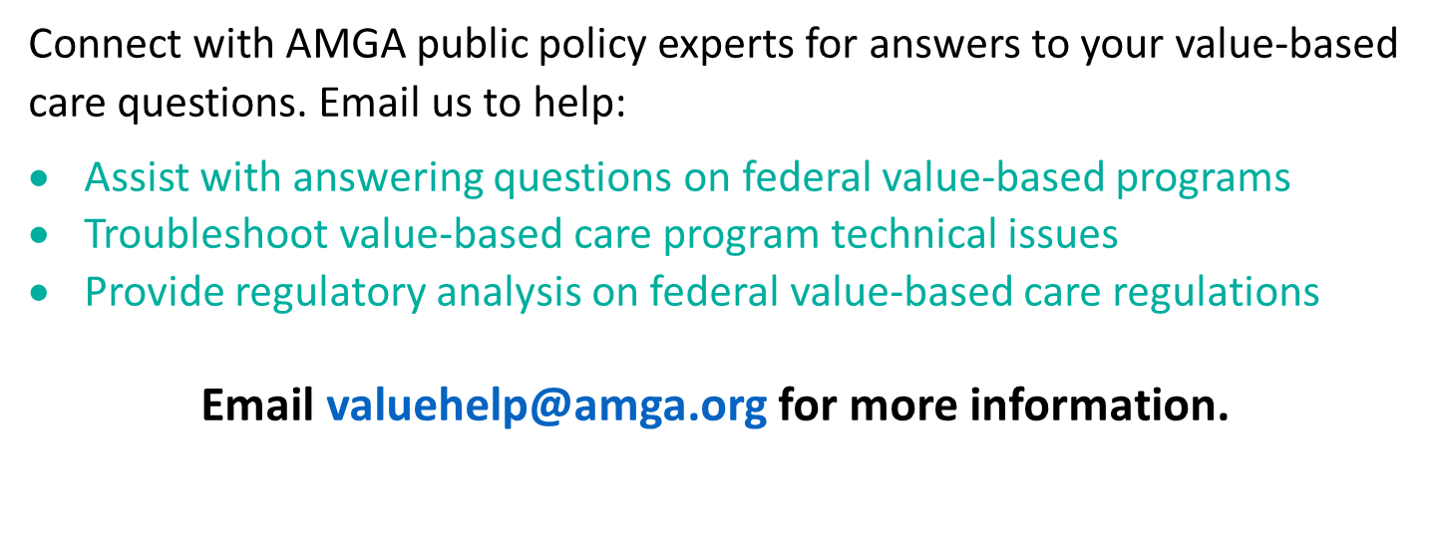

Slide 5


Slide 6





Meet our speakers
Deanna Willis, MD, MBA, FAAFP, FNAP
Endowed Professor of Primary Care and Population Health Research at Indiana University
Dr. Willis is a Professor of Family Medicine. She received her medical degree from the University of Missouri-Columbia and a Masters of Business Administration at Indiana University Kelley School of Business. Dr. Willis is Board Certified by the American Board of Family Practice and has completed the Institute for Healthcare Improvement Year-Long Improvement Advisor program.
Jared Brosch, MD
Associate Professor of Clinical Neurology at Indiana University
Dr. Brosch is an Associate Professor of Clinical Neurology. He earned his medical degree from Indiana University and is Board Certified by the American Board of Psychiatry and Neurology. His clinical interests focus on Alzheimer’s and other dementias and his research focuses on clinical trials for neurodegenerative diseases and neuroimaging of dementia.
John Showalter, MD
Chief Product Officer at Linus Health
Dr. Showalter is the Chief Product Officer at Linus Health and a dual board-certified primary care physician. Prior to joining Linus Health, he spent five years as Chief Product Officer at Jvion, a leader in clinical artificial intelligence. His experience also includes 10 years at health systems, most recently serving as CMIO and CHIO at the University of Mississippi Medical Center.

Slide 7
Preparing for an evolving
Alzheimer’s treatment landscape: Patient & thought leader insights

Slide 8
Agenda
KEY FINDINGS FROM A SURVEY OF 1,000 OLDER ADULTS & IMPLICATIONS FOR PRIMARY CARE
John Showalter, MD, Chief Product Officer at Linus Health
ADVANCING EARLY DETECTION IN PRIMARY CARE
Deanna Willis, MD, MBA, Endowed Professor of Primary Care and Population Health Research at Indiana University
IMPLICATIONS FOR SPECIALTY CARE AND HEALTH SYSTEM PREPAREDNESS
Jared Brosch, MD, Associate Professor of Clinical Neurology at Indiana University
Q&A WITH IU LEADERS
John Showalter, MD, Chief Product Officer Linus Health

Slide 9
Patient Voices on Alzheimer’s & Dementia Report:
What 1000 older adults had to say about prevention, detection, and care
Dr. John Showalter

Slide 10
Survey objectives and methodology
Objectives
To understand the disposition of older adults towards early detection of dementia:
Knowledge of early signs and symptoms of impairment
Awareness of modifiable risk factors and related prevention strategies
Preferences and experiences with cognitive care
Receptivity to different types of interventions
Methodology
Conducted by Wakefield Research for Linus Health in January and February 2023
1,000 nationally representative* US adults aged 65+ years
23 question quantitative survey
Mix of online (950) and telephone (50)
Excluded those with a dementia diagnosis
*Weighted for accurate representation of race/ethnicity, marital status, gender, educational background, and geography.

Slide 11
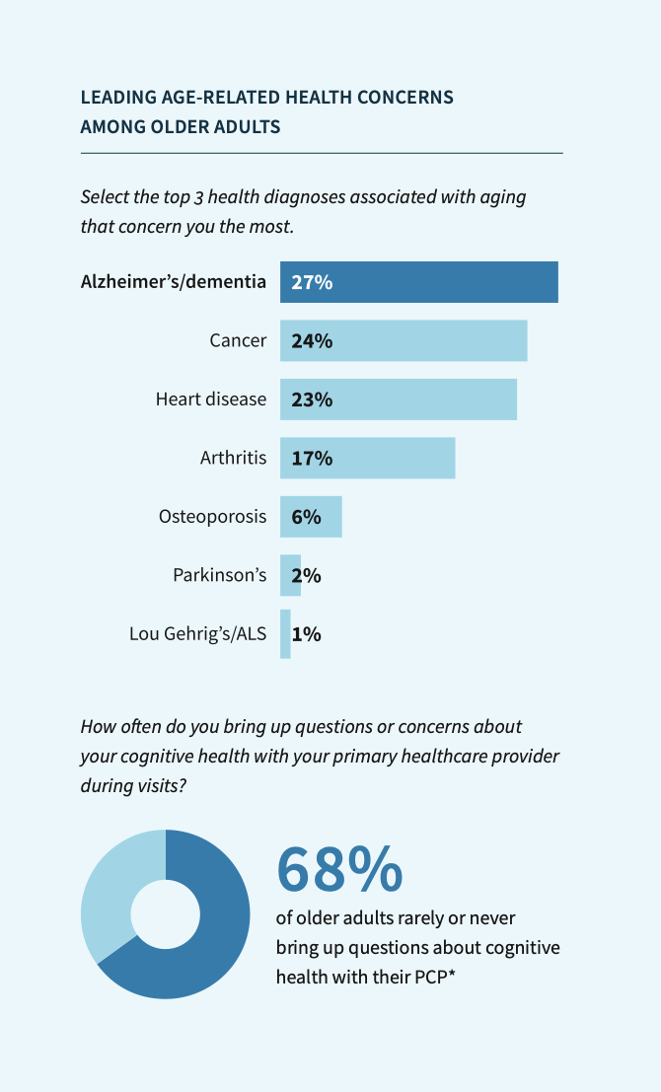
Unspoken concerns
Dementia is top of mind for older adults, but rarely discussed with their PCPs.
81% of those surveyed have at least some concern that they may one day develop Alzheimer’s or another form of dementia
Alzheimer’s and other dementias ranked as the most concerning possible diagnosis as people age
Only 12% say they regularly discuss cognitive health with their PCP*
The majority (68%) report that they rarely or never bring up questions or concerns about their cognitive health with their PCP*
*Among the 97% of respondents who reported having a PCP.

Slide 12
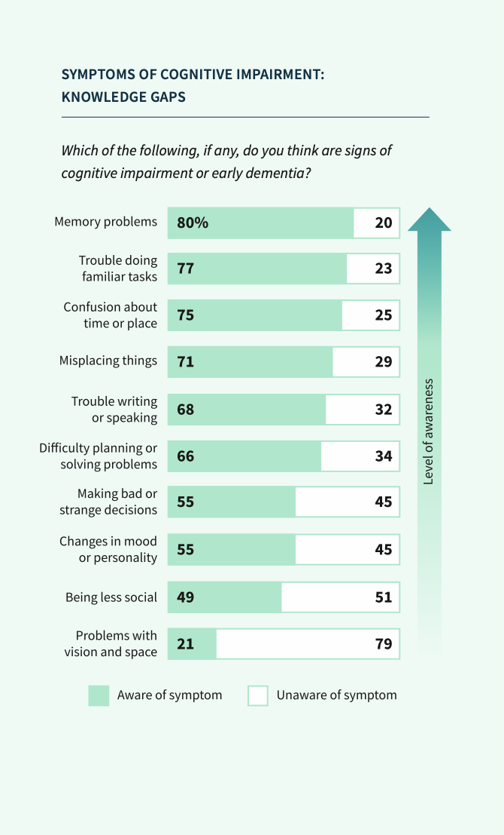
Myths & knowledge gaps
Older adults need more education on the basics of Alzheimer’s and other dementias.
1 in 5 older adults believe that dementia is a normal part of aging
Only 22% report a high level of confidence that they know the signs and symptoms of cognitive impairment, and only 15% correctly identified all symptoms of early cognitive impairment when presented with a list (right)
Nearly half of respondents failed to recognize personality or mood changes, depression, anxiety and social isolation as possible symptoms of cognitive impairment

Slide 13
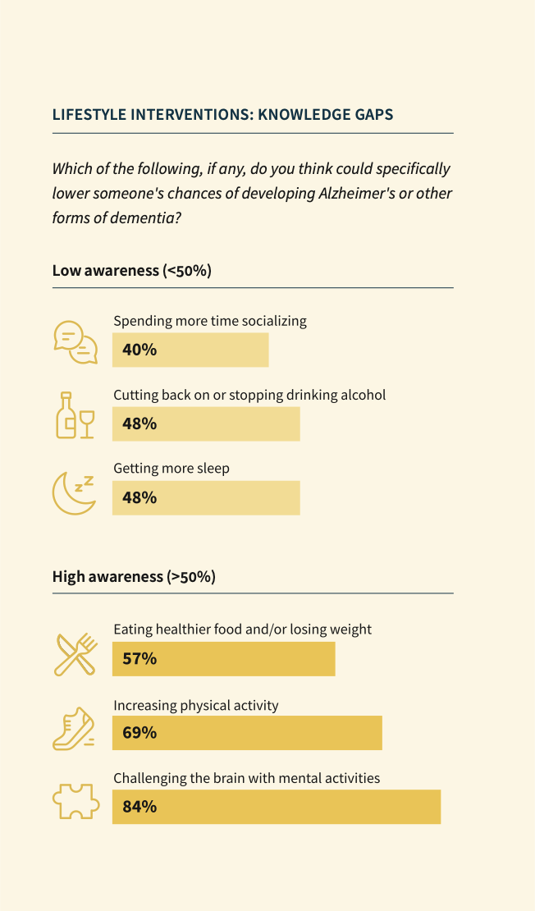
Risk factors & prevention
Many older adults are still unaware of the power of prevention.
Almost 1 in 4 believe that dementia is genetic and there’s not much anyone can do about it
Fewer than half are aware of the role that sleep, alcohol, and social connection play in cognitive health
95% indicate a willingness to make one or more changes to their lifestyle if they knew they were proven to support brain health

Slide 14
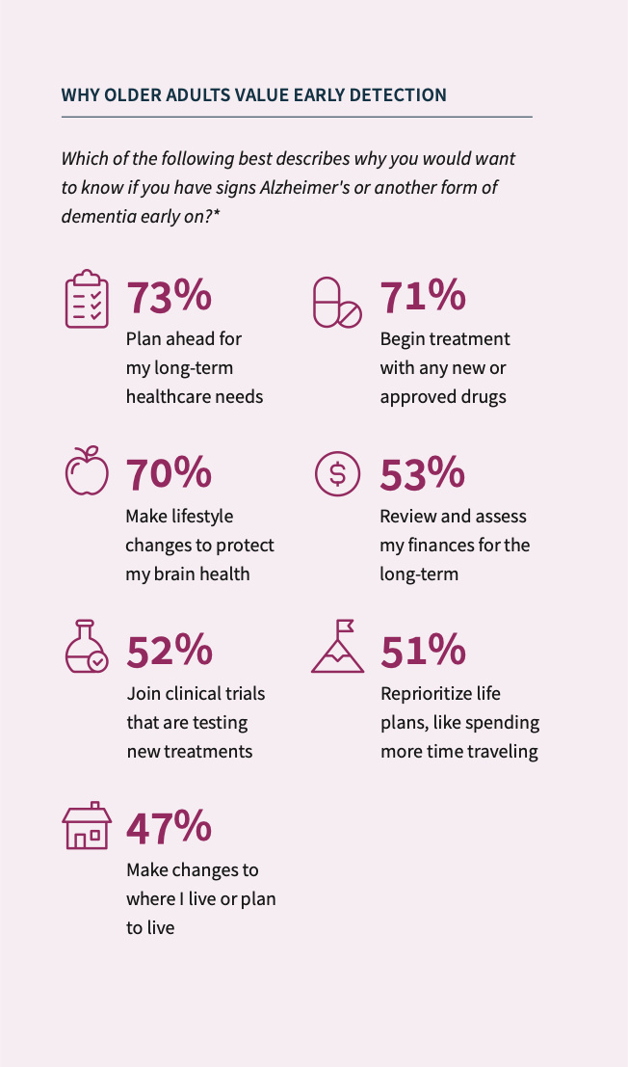
Demand for early detection
Older adults are nearly unanimous in their desire for early detection.
The vast majority of older adults surveyed — 92% — said they would prefer to know about Alzheimer’s and other dementias early on
Ability to plan for long term healthcare needs (73%), begin treatment with pharmaceuticals (71%), and make lifestyle changes to protect their brain health (70%) top the list of reasons why older adults would want to know early
About half of respondents find value in early detection as an opportunity to better plan for the future — financially, personally, and in relation to where they’ll live long-term

Slide 15
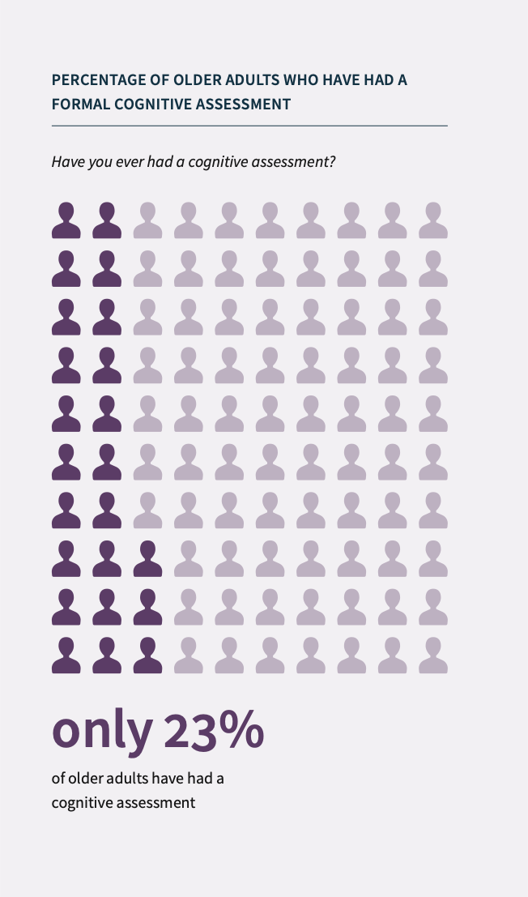
Care preferences vs. realities
Older adults want to get ahead of dementia, but healthcare practices lag behind.
Only 16% of older adults report that their PCP has recommended lifestyle changes to support their cognitive health in the past few years
The majority — 75% — say they would like more information from their PCPs on ways to reduce their risk of dementia
Only 23% of respondents report that they have ever had a cognitive assessment
Low rates of assessment combined with symptom knowledge gaps among patients contribute to a high overall risk of signs of cognitive impairment going unnoticed
*Among the 97% of respondents who reported having a PCP.

Slide 16
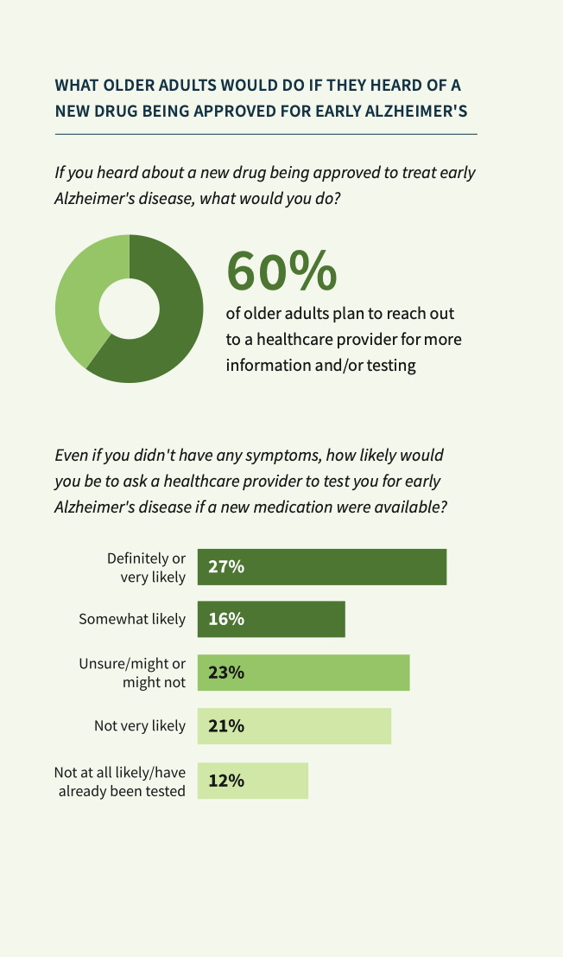
Emerging drug treatments
Older adults are paying attention and plan to take action once treatments are available.
Over 40% of older adults surveyed had already heard of the drug to treat early Alzheimer’s just weeks after the FDA’s approval*
More than 6 out of 10 said they would reach out to a healthcare provider for more information or testing if they heard of a new drug for Alzheimer’s being approved.
Almost 30% of respondents say they would definitely or very likely reach out to a provider to be tested for Alzheimer’s even if they didn’t have any symptoms
9 out of 10 older adults indicate interest in taking a medication to potentially slow Alzheimer’s
*The FDA announced accelerated approval of a new drug treatment of early Alzheimer’s disease on January 6, 2023. This survey was fielded in the weeks immediately following (January 12 — February 8, 2023).

Slide 17
Implications for Primary Care
Dr. John Showalter

Slide 18
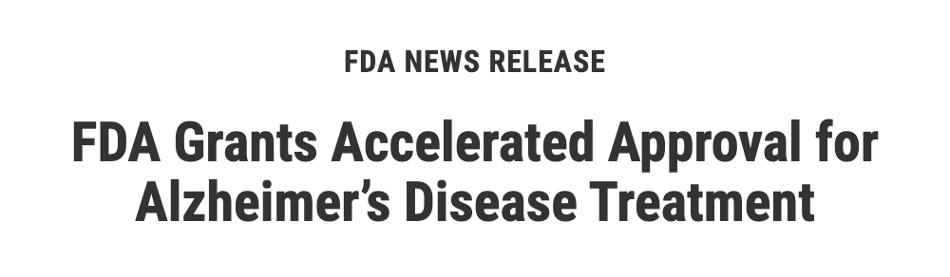
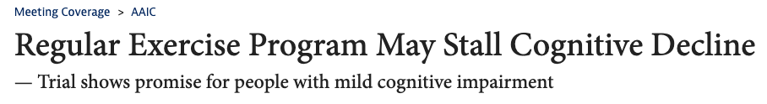

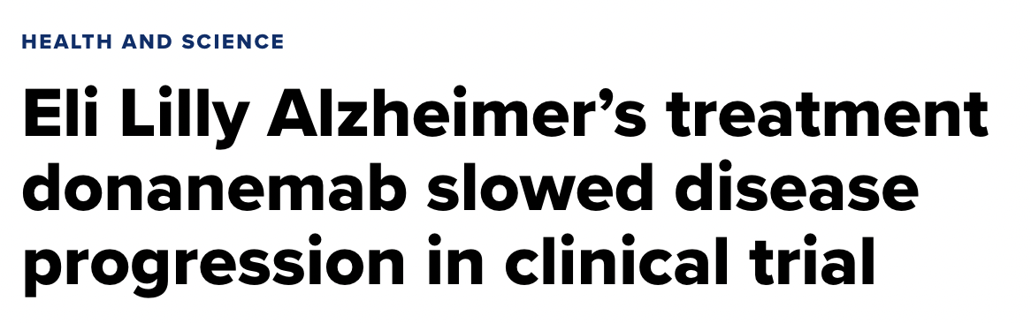

The Alzheimer’s and other dementias interventions landscape is shifting rapidly — but is our healthcare system ready?
New treatments being approved
Expanding evidence on lifestyle interventions
Notes:
The treatment and interventions landscape is shifting rapidly. With the recent FDA accelerated approval of a drug to treat early Alzheimer’s (Lecanemab) and new data coming out on the impact of lifestyle interventions, the treatment landscape is evolving and early detection is more critical than ever.
FINGER was the first study to demonstrate that a multidomain intervention of diet, exercise, cognitive training, and vascular risk monitoring can preserve cognitive functioning in older adults who have a high dementia risk.
The preliminary results of the EXERT trial are promising, as the data reinforces the impact of exercise on neurological function, but also suggests that aerobic and anaerobic exercise are equally effective in preventing cognitive decline.
https://n.neurology.org/content/neurology/99/8/e799.full.pdf

Slide 19
The current approach to brain health is reactive
Symptoms
Complaint
Specialist evaluation
Diagnosis
Treatment
Impaired function
Assessments usually occur only after symptoms arise
Diagnosis happens too late
Impact of interventions is limited due to delays

Slide 20










Primary care is critical to enabling more proactive cognitive care
Personalized interventions
Fast and accurate triaging
Early detection
Early intervention
Patient and family support
Primary care team
Longitudinal monitoring
Notes:
PCP audience - even with a new medication, prevention-related activity is the most powerful role PCPs can play
This isn’t happening in primary care today - but look at all we can do here for prevention
Paint a picture of near future for PCPs and their role in brain health
Not an actual program - but a frame of reference for what “lifelong brain health” looks like in primary care

Slide 21
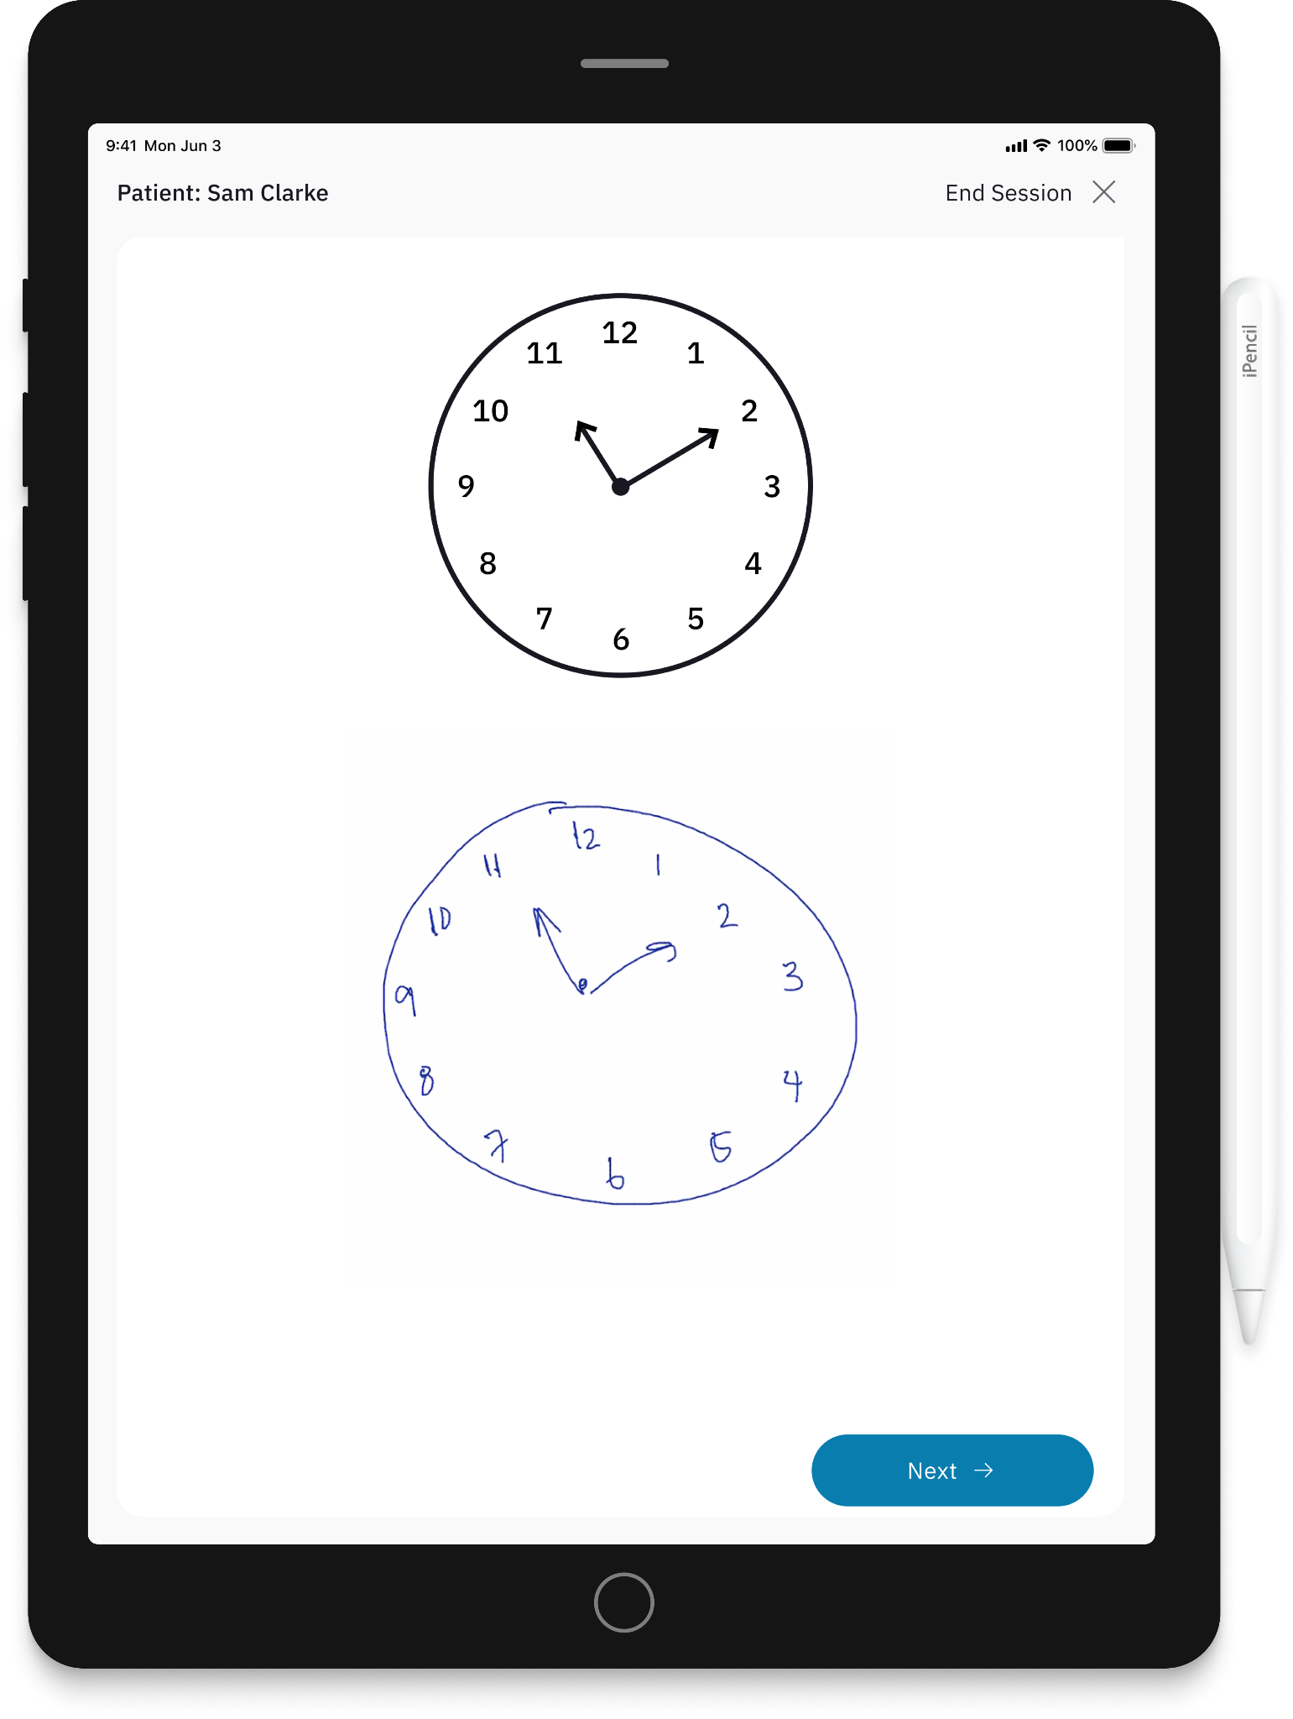
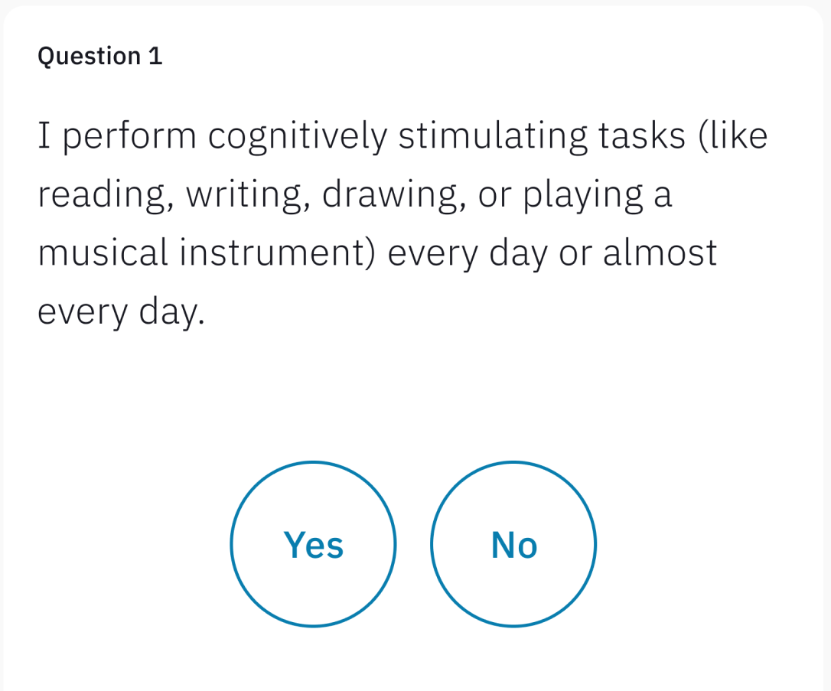
Primary care needs enhanced support and tools
LINUS HEALTH’S CORE COGNITIVE EVALUATION:
Digital Clock and Recall (DCR™)
Immediate verbal recall: Patient repeats back three words
DCTclock™: Patient draws two clocks
Delayed verbal recall: Patient repeats same three words, without reminder
OVERALL SCORE (OUT OF 5):
GREEN (4-5)
Not indicative of cognitive impairment
YELLOW (2-3)
Borderline for cognitive impairment
Life & Health Questionnaire (LHQ)
Digital patient survey that uncovers modifiable risk factors for cognitive impairment and dementia
RED (0-1)
Indicative of cognitive impairment
Notes:
We know cognition is more than just the ability to perform tasks. Cognition is impacted by qualitative factors – feelings of depression, a sense of connection to community, and a feeling of purpose, etc. Our assessment takes these important factors into account.
Digital patient survey that uncovers modifiable risk factors for cognitive impairment through a series of yes/no questions

Slide 22
Advancing Early Detection in Primary Care
Dr. Deanna Willis

Slide 23
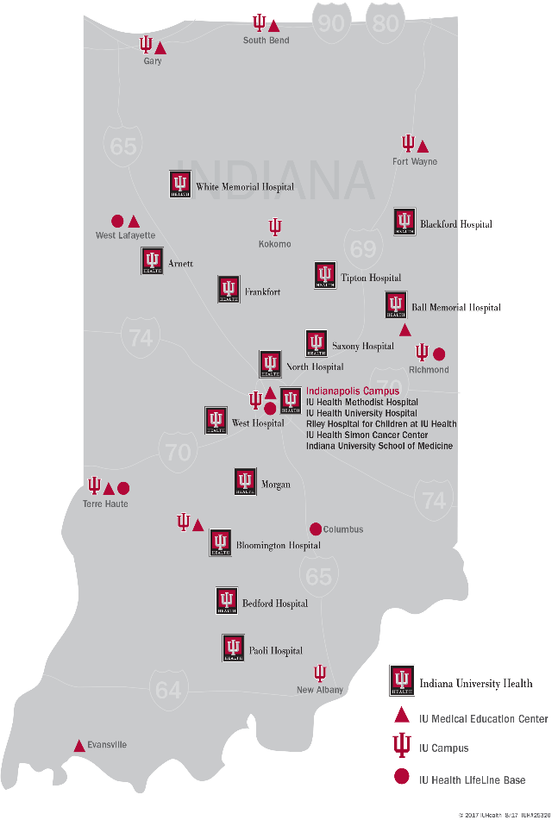
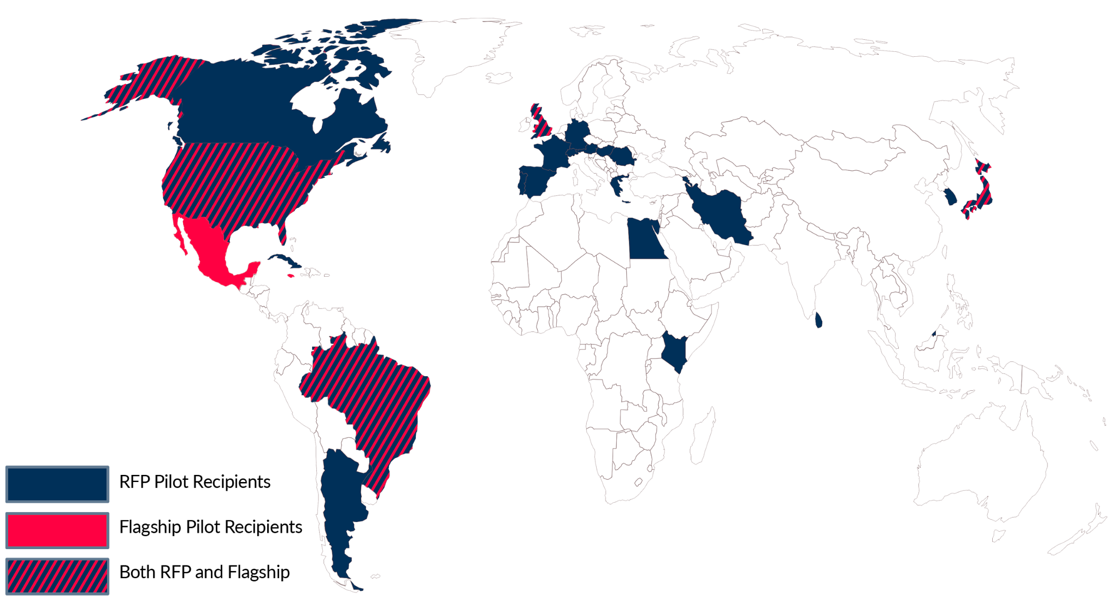
Background
Notes:
General Background
Initially launched as part of the Davos Alzheimer’s Collaborative’s Healthcare System Preparedness Project focused on advancing early detection with new approaches and tools in primary care settings
IU Health one of seven international Davos flagship sites involved to test new methods and develop associated workflow best practices etc. to support more widespread cognitive assessments in primary care
IU Health Program Design
6 primary care clinics involved
Focused on patients 65 years and older — engaged during existing appointments
Added Brain Health Navigator (BHN) to support triage for abnormal results
Significant focus up front on clinical workflow design

Slide 24
Primary Care Workflow and Care Paths (Sample)
Pre-visit:
Patient selection & preparation
During visit:
DCA screening
Post-visit:
Patient follow-up
Follow-up appt:
Brain Health Navigator assessment
Approach adapted by local providers and staff
Some practices employed case-finding at this stage
Nudge in EHR prompting screening
Patient is roomed
DCA administered
DCA results into EHR
Provider reviews and discusses results with patient and caregivers
Provider and patient/caregivers decide next steps
Brain Health Navigator appointment offered
Montreal Cognitive Assessment (MoCA) performed
Reversible causes evaluation (PHQ9, GAD7, TSH, B12, MRI)
Community resources offered
Clinical trial eligibility explored
Recommendations sent to PCP
Follow up call 1-2 weeks later

Slide 25


Key Barriers to Overcome and Lessons Learned
PROVIDER
Perceived lack of
treatment efficacy
Concerns about correct management of patient independent function
PRACTICE
Competing demands
Burnout
Need for local adaptation
TECHNOLOGY
Real world challenges
of noise, space, standardization
Sensitivity vs. provider clinical judgement

Slide 26
Implications for Specialty Care and
Health System Preparedness
Dr. Jared Brosch

Slide 27
DCR Pathway at IUH
GREEN (4-5)
YELLOW (2-3)
RED (0-1)
Not indicative of cognitive impairment
Borderline for cognitive impairment
Indicative of cognitive impairment
Encourage lifestyle management
Consider referral to
Brain Health Navigator
Encourage lifestyle management
Consider referral to
Brain Health Navigator
Recommend blood biomarker test
Referral to Neuro/Geriatrics

Slide 28
IUH DCR Results — Capturing opportunities for earlier intervention
Site | Green (DCR 4-5) | Yellow (DCR 2-3) | Red (DCR 0-1)
1 | 83 | 130 | 72
2 | 17 | 9 | 3
3 | 115 | 100 | 28
4 | 214 | 117 | 35
5 | 223 | 169 | 43
6 | 9 | 8 | 4
Total | 661 (48%) | 533 (39%) | 185 (13%)
Prospective tx eligibility rates among Brain Health Navigator referrals (Yellow or Red)
77% (30/39)
75% (3/4)
63% (5/8)
83% (5/6)
75% (9/12)
100% (1/1)
76% overall
Data represented: June - Dec 2022

Slide 29
Impact on patient care
Large portion (>⅓) of Yellow (borderline for cognitive impairment) → How should providers interpret and take action on a “borderline” result?
Yellow and Red (indicative of cognitive impairment) DCR results consistent with MoCA follow-up results, suggests decline above that of normal aging
Opportunities identified for early intervention
  Modifiable risk factors flagged by Brain Health Navigator intermediate role
  Earlier referrals to neurologists – catching patients while they are still Yellow may be key to treatment
  Patients with Red results fall in appropriate range for intervention too

Slide 30
The “why” behind it all
Preparing for Emerging Treatments
Dependencies for Impact
FDA has approved both Aducanumab (Aduhelm) and Lecanemab (Leqembi), additional drugs in pipeline
Leqembi has had 2 POSITIVE clinical trials showing a 27% slowing of the rate of cognitive decline in AD and a low rate of side effects (~12%).
Expectation is that it will be FULLY approved with some form of Medicare coverage in 2023.
Expected eligibility criteria: MCI was >60% of the individuals in the study. MILD dementia was 40%. MMSE >22.
Earlier treatment means more time and less
side effects
Primary care is the KEY to identifying individuals
with MCI who can receive treatment
If people are already struggling a lot at home it
may be too late

Slide 31
Q&A with IU Leaders
Moderated by Dr. John Showalter

